Slide 1
Strain Gauges: Present and Future
Applications of Electronics

Slide 2
Objectives:
Analyze series-parallel DC circuits
Build and take measurements in series-parallel DC Circuits
Use innovative and critical thinking to analyze a problem.

Slide 3
In this module, we'll answer the following questions:
How do you “redraw” the Wheatstone Bridge circuit to recognize the series-parallel relationship among the resistors?
How is a strain gauge used in a Wheatstone Bridge?
How does the elastomer strain gauge work?
How can you apply the elastomer strain gauge to a structure?
What tests and evaluations would you need to do to show that the elastomer strain gauge is accurate and reliable?

Slide 4
What is a strain gauge?
Strain Gauge video

Slide 5
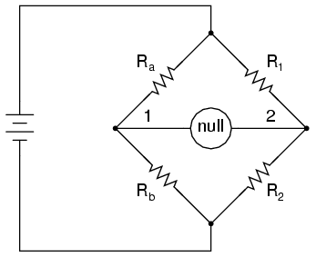
Back to Series-Parallel Circuits: The Wheatstone Bridge
Voltage output is zero when the bridge is “balanced”
R_{a}/R_{b} = R₁/R₂

Slide 6
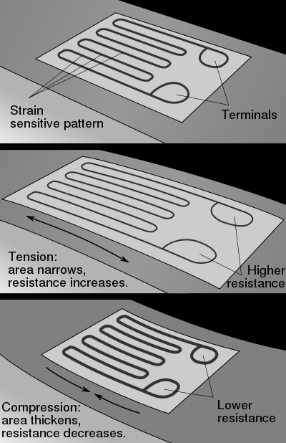
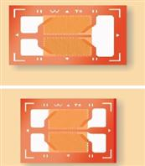
Foil Strain Gauge
One leg of the Wheatstone Bridge

Slide 7
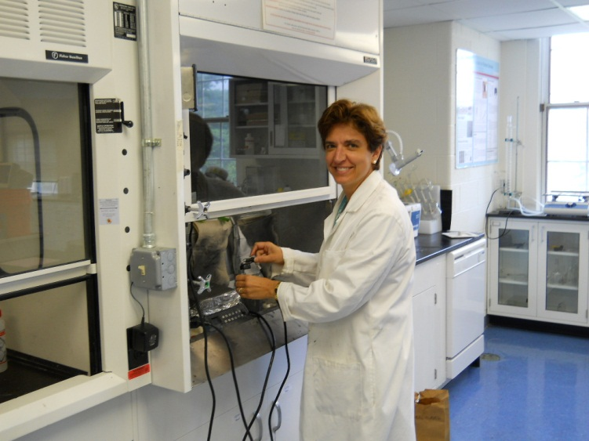
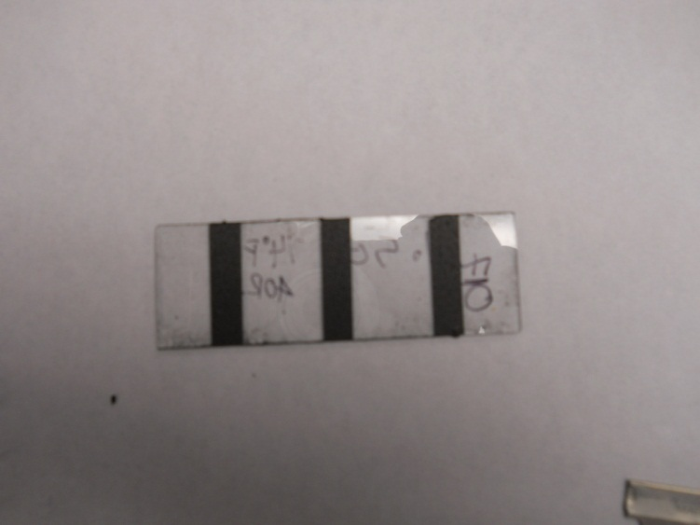
Elastomer Strain Gauge
Graphene particles in Latex
Resistance varies with strain (displacement)

Slide 8
Some things to consider:
Concept of operation
Application examples from the literature
How does it compare with a foil strain gauge in terms of ease of use, reliability, and durability?
What tests would you do to “demonstrate” that elastomer strain gauge is a viable product?

